Slide 1

Hack 4 Good
FOR A GREATER GOOD
Kent Ridge
Regression

Slide 2
Together, we can harness technology for social good, fostering innovation that doesn't just change lives— but uplifts entire communities.
Kent Ridge
Regression

Slide 3



PROBLEM STATEMENT
Design and develop a web-based Minimart and Voucher System for Muhammadiyah Welfare Home, enabling users to request products and earn vouchers while providing administrators with robust management and reporting tools.
Kent Ridge
Regression

Slide 4
Kent Ridge
Regression
PRODUCT
Admin Control
Admin Control
Admins are given full access to all activities required, including password resetting, adding and reducing product stock, allocating vouchers and approving / rejecting voucher requests
Simple Interface
Simple Interface
Users
Clean, easy access to all functions available on a single page: Requesting vouchers, perusing products available and viewing transaction histories
Admin
Simple overview of products and users on the platform and
Fully Functional
Basic Prototype
Fully Functional Basic Prototype
Developed a fully functional web application with frontend and backend that works off the bat with minimal additional work required

Slide 5
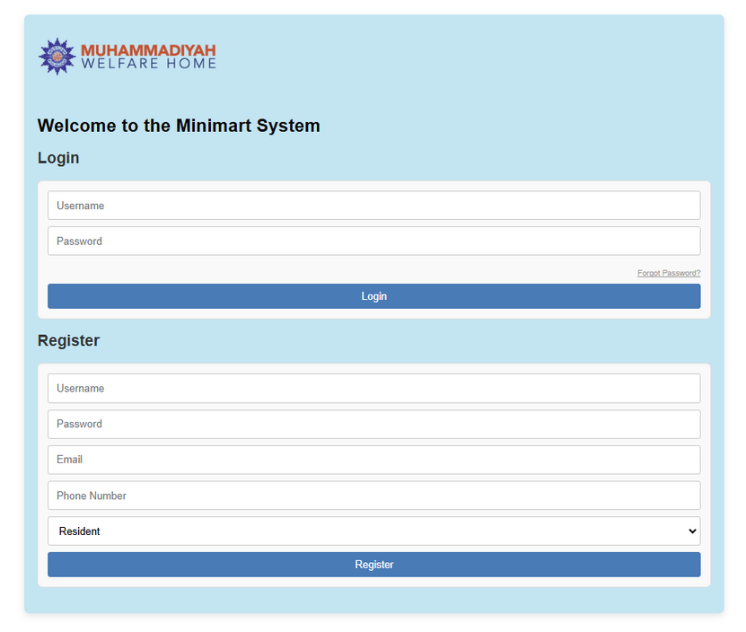
BASIC PROTOTYPE
Login System
“Forgot Password” on bottom right allows users to easily reset their passwords
Registration System
Simply enter necessary details - username, password, email, phone number - and choose role (Resident / Admin) and click “Register”
Verification checks are in-built into the form - unique username, unique email and complexity of password
Kent Ridge
Regression

Slide 6
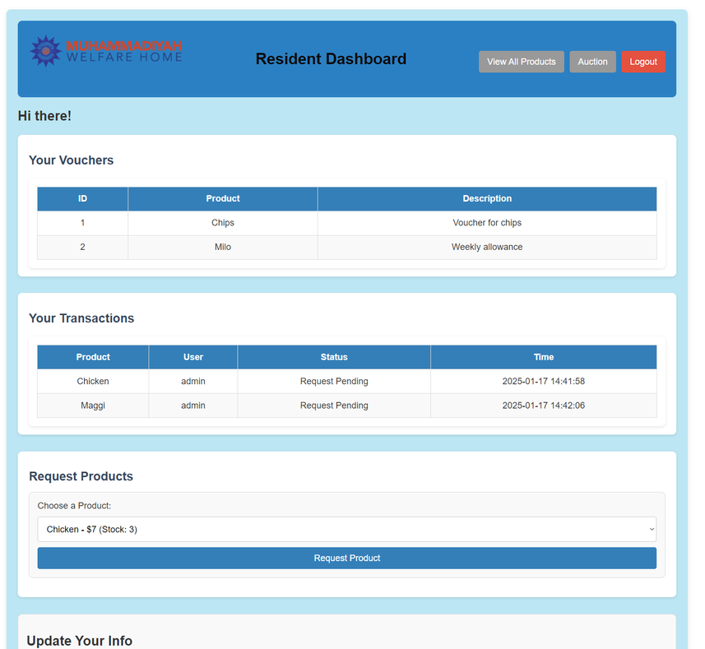
BASIC PROTOTYPE
Dashboard for Residents:
An Overview of
Available Vouchers for use
Transaction History
User Functions
Submit request for products or vouchers with just the click of a button
Update your personal info or change password easily
Kent Ridge
Regression

Slide 7
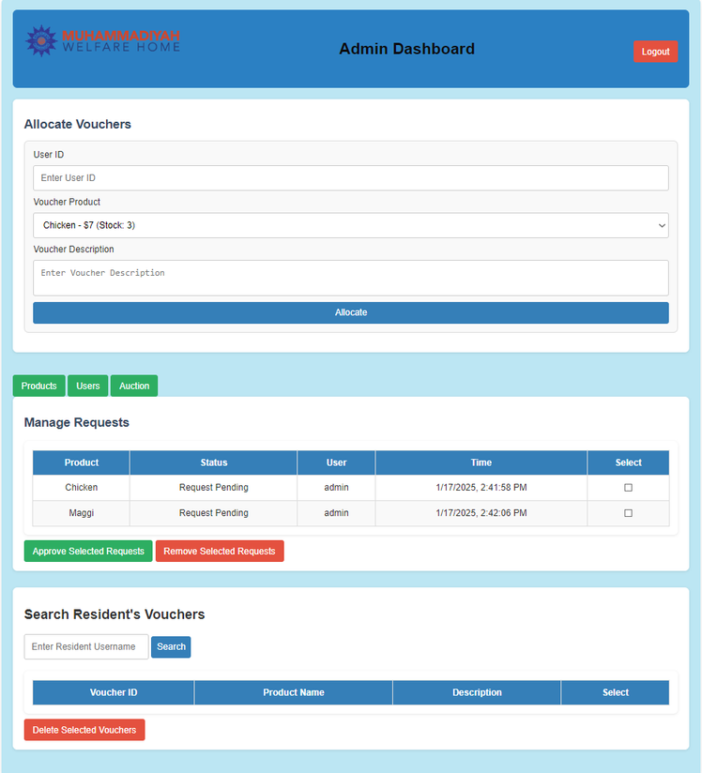
BASIC PROTOTYPE
Dashboard for Admin Users:
An Overview of
Open Requests made by Users
Identifying vouchers allocated to specific users
Kent Ridge
Regression

Slide 8
ADMIN CONTROL
Admin Dashboard Functions
Allocation of specific vouchers to specific users
Recall / Cancel specific users’ vouchers
Kent Ridge
Regression

Slide 9
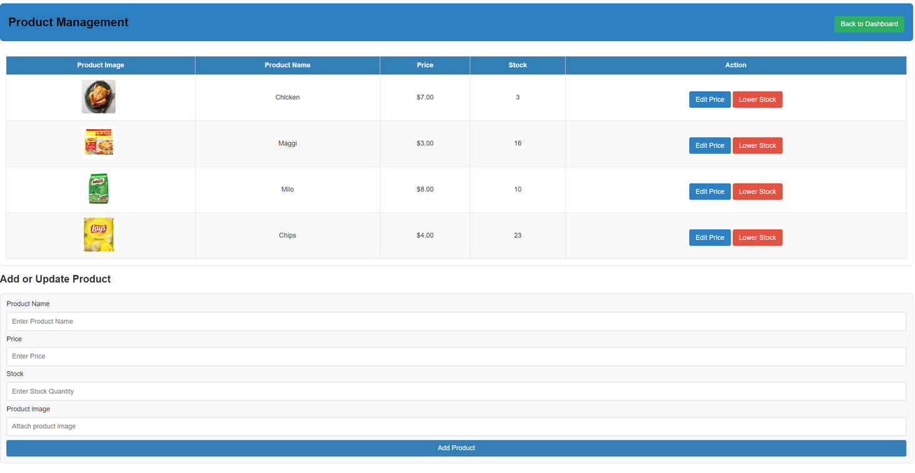
ADMIN CONTROL
Full Control of Available Products
Easily view product catalogue
edit prices of available products
reduce the stock of products
Add new products with specific price and stock set by admin (optional: product image)
Update product stock easily through the same interface
Kent Ridge
Regression

Slide 10
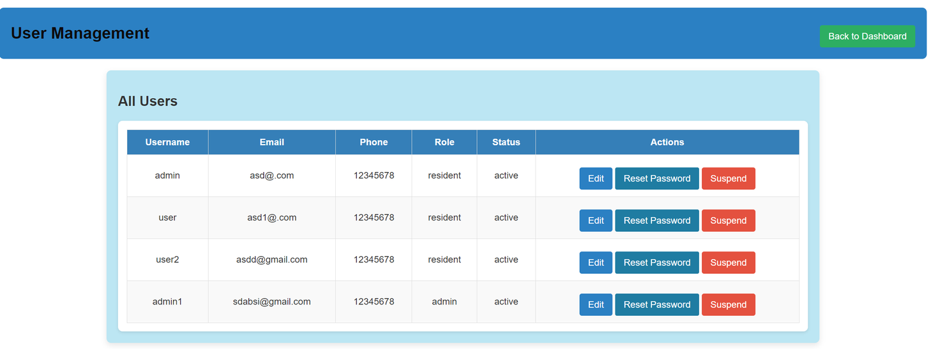
ADMIN CONTROL
Full Control over Users
Table View of Users
Identify role of users (resident / admin), status (active / suspended) with user details at a glance
Functions
Reset passwords of users if necessary
Suspend / Unsuspend users
Kent Ridge
Regression

Slide 11
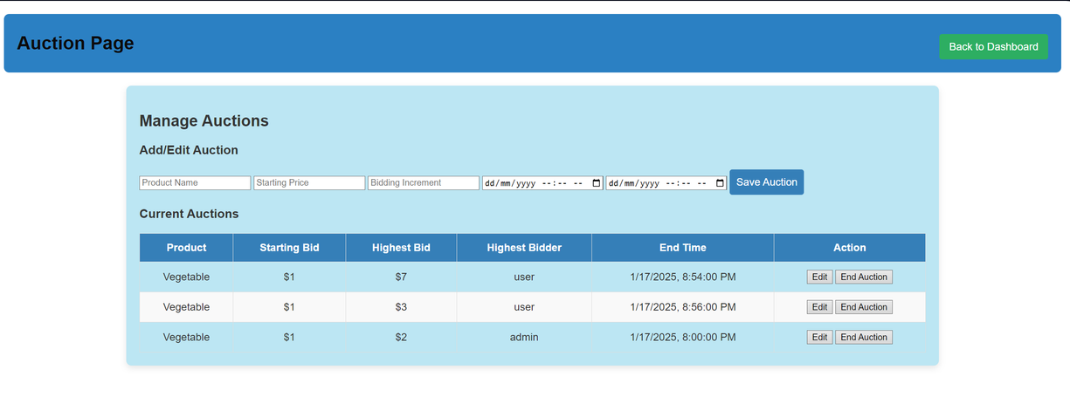
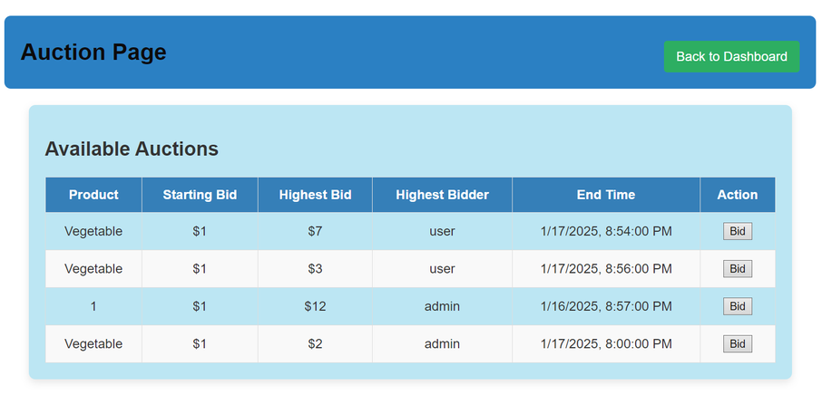
Kent Ridge
Regression
EXTENSIONS - AUCTIONS
ADMIN
Schedule auction events to start and end at any specified time
Edit auction end time at any point during the event if necessary
Concurrent auctions possible to allow for multiple products to be auctioned off simultaneously
Clear overview of all auctions currently ongoing in table
USER
Clear overview of all auctions currently ongoing
Easy interface for bidding

Slide 12
Kent Ridge
Regression
FUTURE DEVELOPMENT
Rationale
Admins are currently provided an abundance of flexibility so as to accommodate various functions required
With experience, required functionality could be easily extended upon from our current prototype

Slide 13
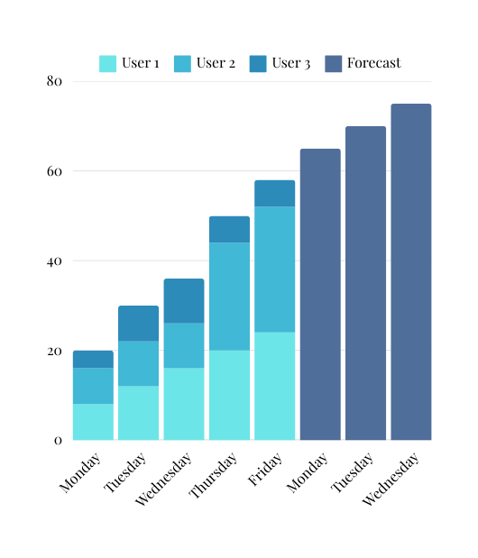
Kent Ridge
Regression
FUTURE DEVELOPMENT
E.g. of Weekly Report
Weekly Reports
Daily requests made by users for products
Integration of Akkio / Salesforce AI products to introduce automation and forecasting of inventory requirements

Slide 14
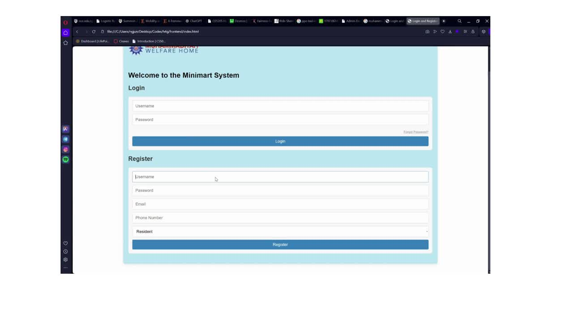
Kent Ridge
Regression
PRODUCT DEMO

Slide 15
Kent Ridge
Regression
Thank you!
KENT RIDGE REGRESSION

